Slide 1
Tritiated Methane as an Internal Calibration Source in Dark Matter Detectors
Richard Knoche
Candidacy Talk, May 16th 2013

Slide 2
Overview
Introduction to Dark Matter
Direct Detection of WIMPs
The Large Underground Xenon Detector (LUX)
Internal Calibration Source
Gas Phase Experiments
Liquid Phase Experiments
Simulations for LUX

Slide 3
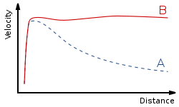
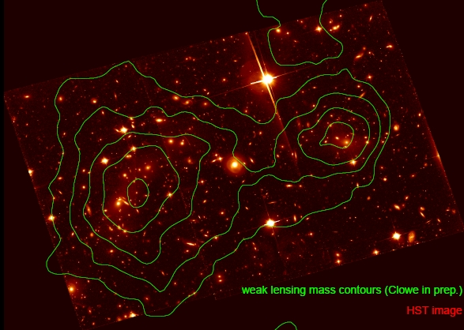
Evidence of Dark Matter
Rotational velocities of
galaxies inconsistent with
Newtonian gravity
Gravitational lensing of
cosmological objects, such as the Bullet Cluster

Slide 4

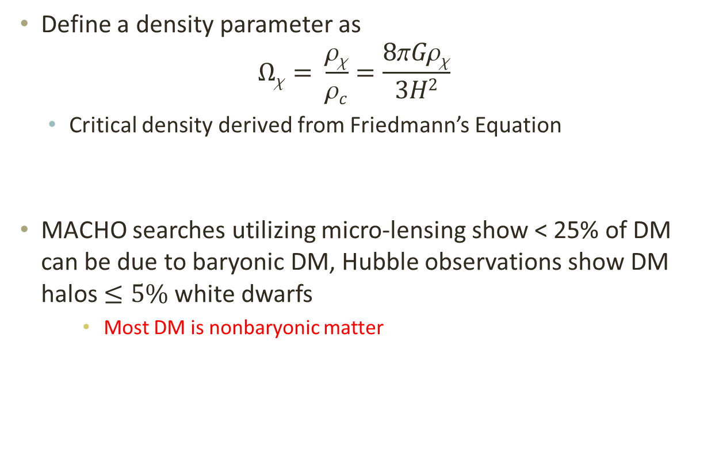
Composition of the Universe
Define a density parameter as
$$Ωχ= \frac{ρχ}{ρc}=\frac{8πGρχ}{3H2}$$
Critical density derived from Friedmann’s Equation
MACHO searches utilizing micro-lensing show < 25% of DM can be due to baryonic DM, Hubble observations show DM halos $≤5\%$ white dwarfs
Most DM is nonbaryonic matter

Slide 5
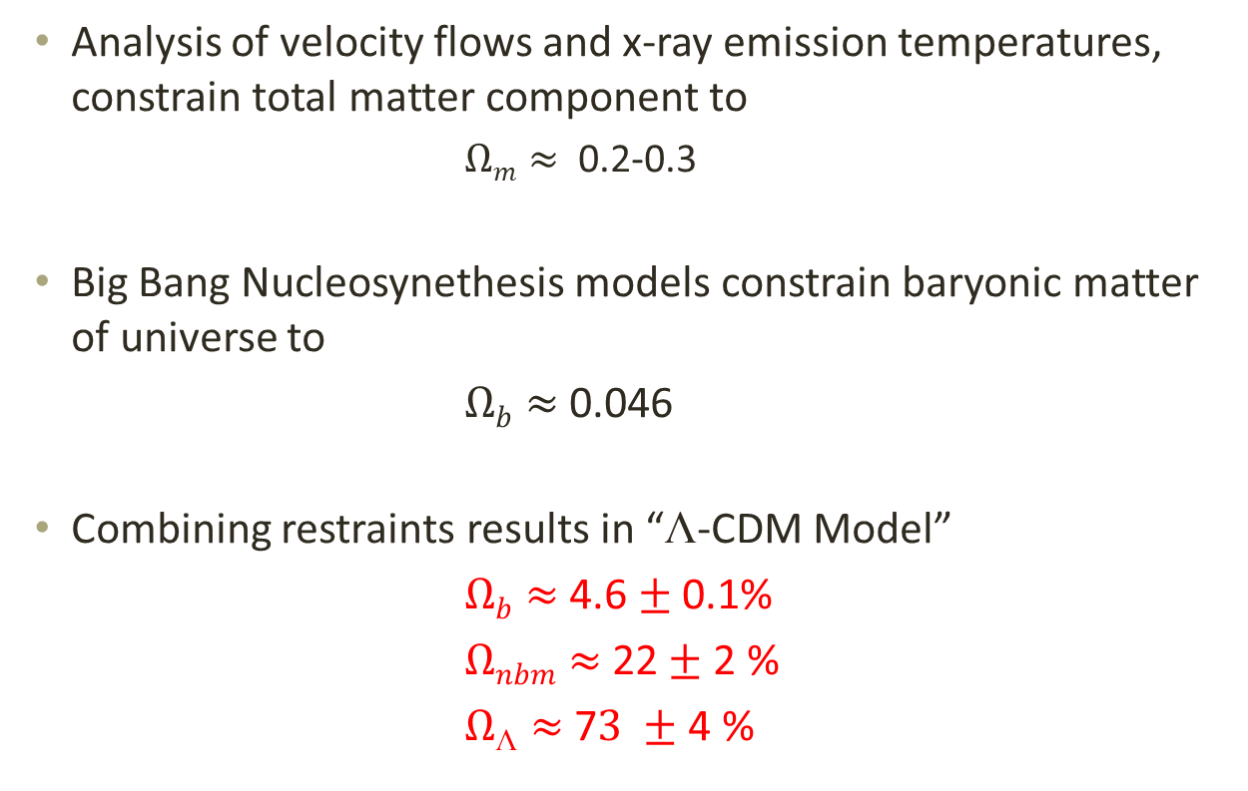
☹-CDM Model
Analysis of velocity flows and x-ray emission temperatures, constrain total matter component to
$Ωm≈$ 0.2-0.3
Big Bang Nucleosynethesis models constrain baryonic matter of universe to
$Ωb≈$ 0.046
Combining restraints results in “☹-CDM Model”
$Ωb≈$ 4.6 $±$ 0.1%
$Ωnbm≈$ 22$±$ 2 %
$Ω☹≈$ 7$3 ±$ 4 %

Slide 6
Dark Matter Candidates
Axions and Axinos
Gravitons and Gravitinos
Neutrinos
WIMPs

Slide 7
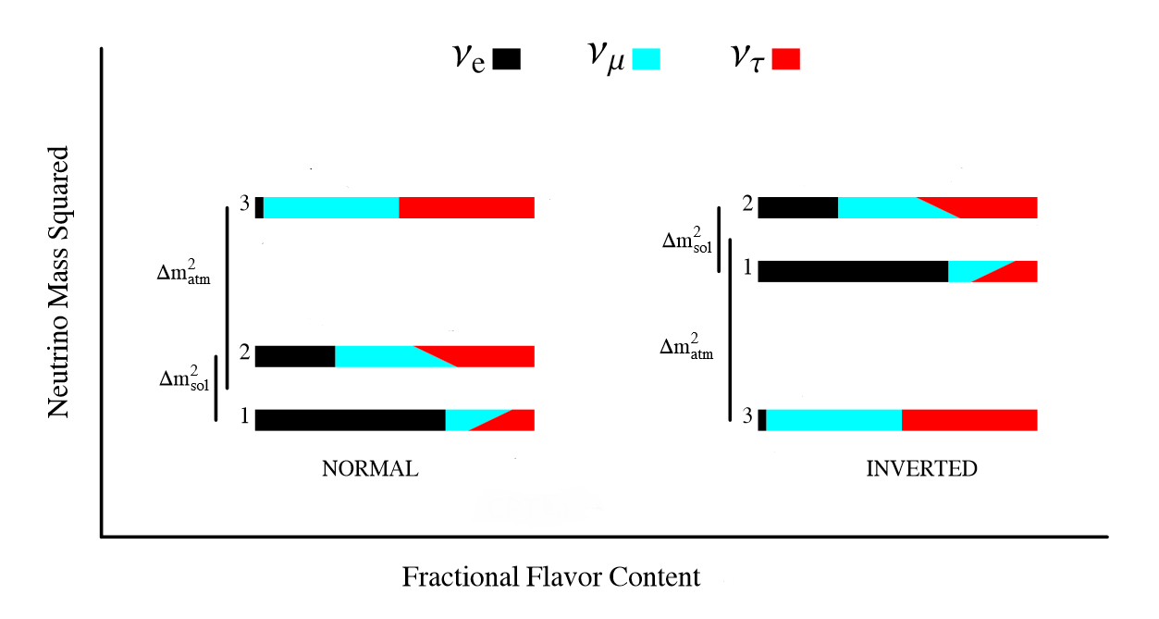

Neutrinos
Electrically neutral, weakly interacting particle with low mass
“Hot” Dark Matter
Three flavor states, composed of superposition of three mass states
m² = (7.66 $±$ 0.35) x 10⁻⁵ eV² for solar neutrino doublet
m² = $±$(2.38 $±$ 0.27) x 10⁻³ eV² Remaining mass difference

Slide 8
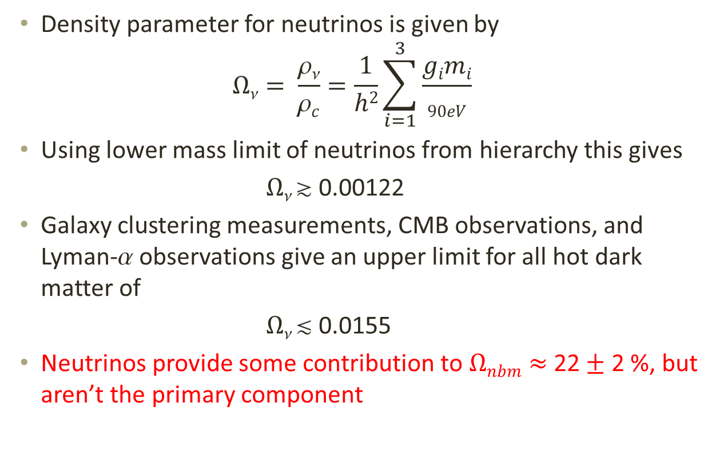
Neutrinos
Density parameter for neutrinos is given by
$$Ων= \frac{ρν}{ρc}=\frac{1}{h2}\sum_{i=1}^{3}{\frac{gimi}{90eV}}$$
Using lower mass limit of neutrinos from hierarchy this gives
$Ω $ 0.00122
Galaxy clustering measurements, CMB observations, and Lyman- observations give an upper limit for all hot dark matter of
$Ω $ 0.0155
Neutrinos provide some contribution to $Ωnbm≈$ 22$±$ 2 %, but aren’t the primary component

Slide 9
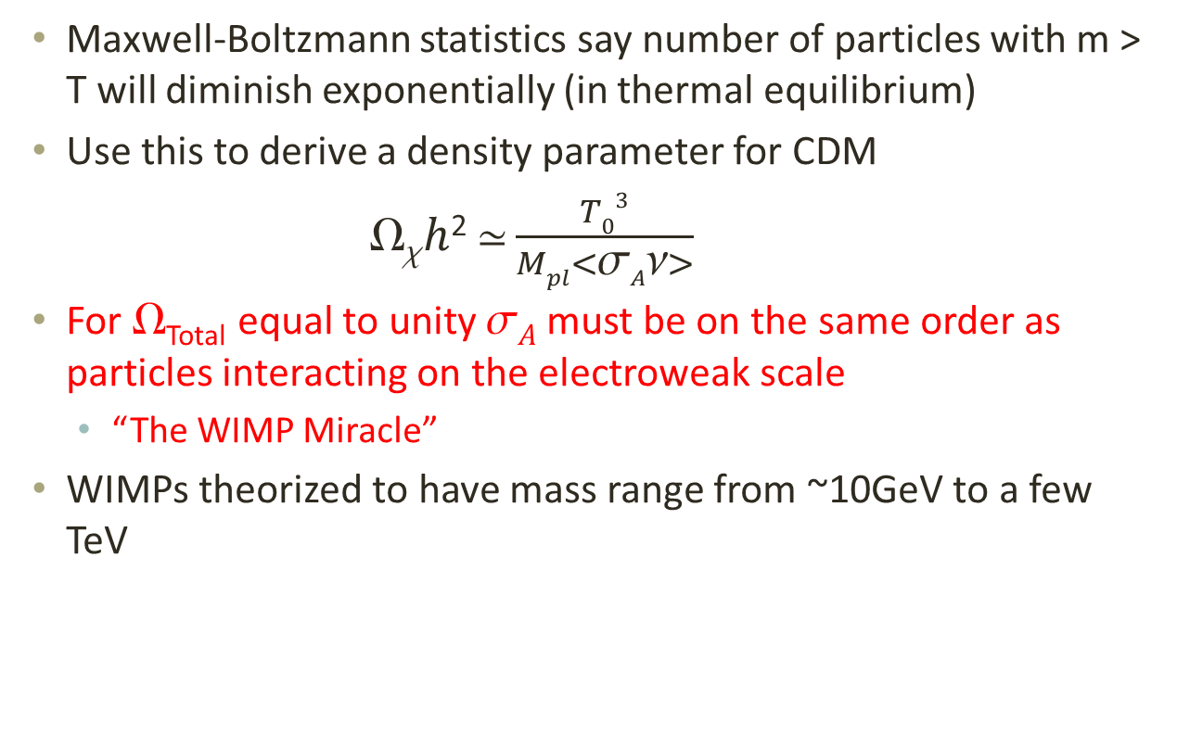
Cold Dark Matter
Maxwell-Boltzmann statistics say number of particles with m > T will diminish exponentially (in thermal equilibrium)
Use this to derive a density parameter for CDM
$h$²$ \frac{T03}{Mpl<σAν>}$
For _{Total} equal to unity $A$ must be on the same order as particles interacting on the electroweak scale
“The WIMP Miracle”
WIMPs theorized to have mass range from ~10GeV to a few TeV

Slide 10
WIMPs and SUSY
SUSY requires supersymmetric partner particles exist for each standard model particle
Sleptons, squarks, gauginos, higgsinos
Haven’t been discovered, thought to be very massive
Neutral gauginos and neutral higgsinos are theorized to mix into a superposition called the neutralino
Lightest supersymmetric particle (LSP)
LSP is stable in models which conserve R-parity
Possible candidate for dark matter
Predicted cross section of 0.192 <  < 0.263 (Dependent on SUSY parameter space)

Slide 11





Direct Detection of WIMPs
WIMPs interact via nuclear recoils in terrestrial detectors
Expect energy recoil spectrum given by
Cross section has spin-independent (SI) and spin-dependent (SD) components

Slide 12
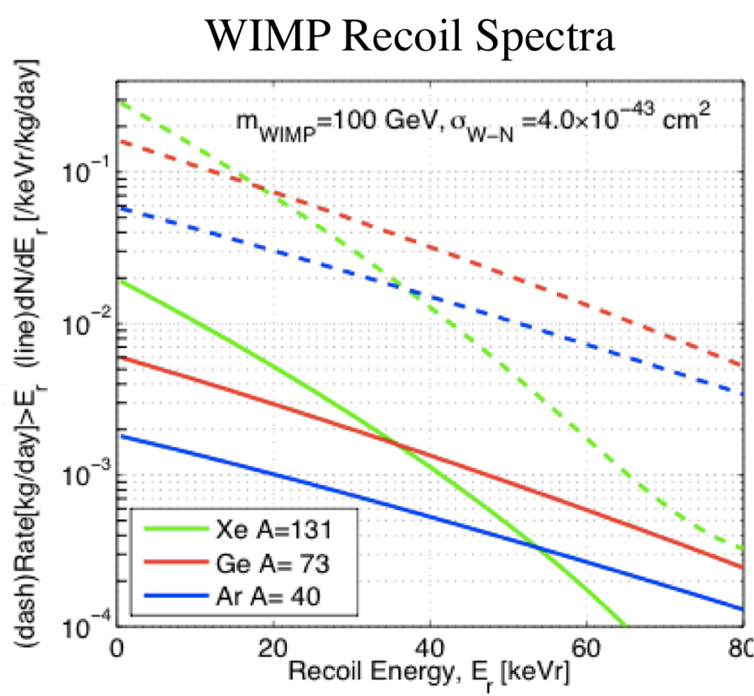
Direct Detection of WIMPs
Lighter target nuclei produce lower event rates due to A² dependence of cross section
Heavier nuclei have a sharper recoil energy spectrum due to form factor suppression
Other events include:
Electron recoils
Gamma rays and X-rays
Nuclear recoils
WIMPs and neutrons

Slide 13
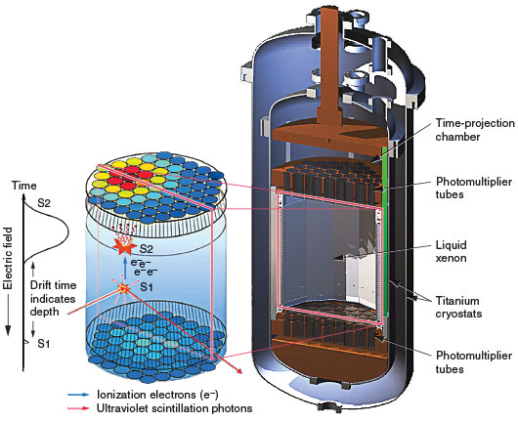
The LUX Detector
Dual phase time projection chamber
350 kg of xenon
PMT arrays in liquid and gas
Scintillation (S1) and
ionization (S2) signals

Slide 14
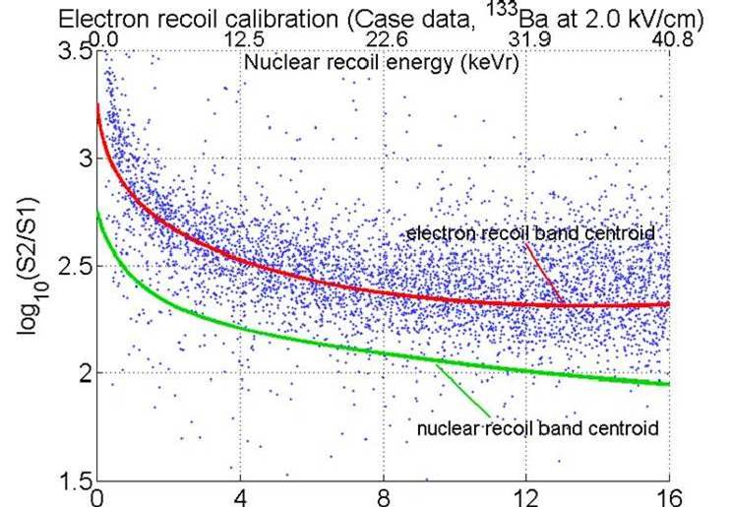
Calibration of the Detector
Nuclear recoils have higher ionization density,
leads to higher recombination probability, and higher S1/S2 ratio
Neutron source is used to generate nuclear recoil band
Beta or gamma emitter is used to generate electron recoil band
Typically external Cs-137 source
Xenon in LUX is self-shielding
Scattering Length ~ 30 cm at
174 nm wavelength
External sources do not
penetrate far enough

Slide 15
Internal Calibration Source
Single beta emitter in energy range of interest (<15 keV)
Low electronegativity so that drift length is unaffected
Can not attenuate UV scintillation
Can dissolve into liquid xenon
Long enough life time to diffuse throughout detector
Must be removable after use
Short enough life time to decay away
Alternatively, something that can be removed through purification

Slide 16
Tritium as an Internal Source
Beta emitter with Q-value of 18.6 keV
Broad spectrum over entire energy range of interest
12.3 year half life
Will diffuse through detector
Must be purified away
Sticks to most surfaces
Teflon, polyethylene, steel, etc.

Slide 17
Tritiated Methane
Methane is inert due to fully saturated carbon-hydrogen bonds.
Diffusion constant in polyethylene that is 10 times smaller than hydrogen
Low electronegativity
Use tritated methane (CH3T) as an internal calibration source!

Slide 18
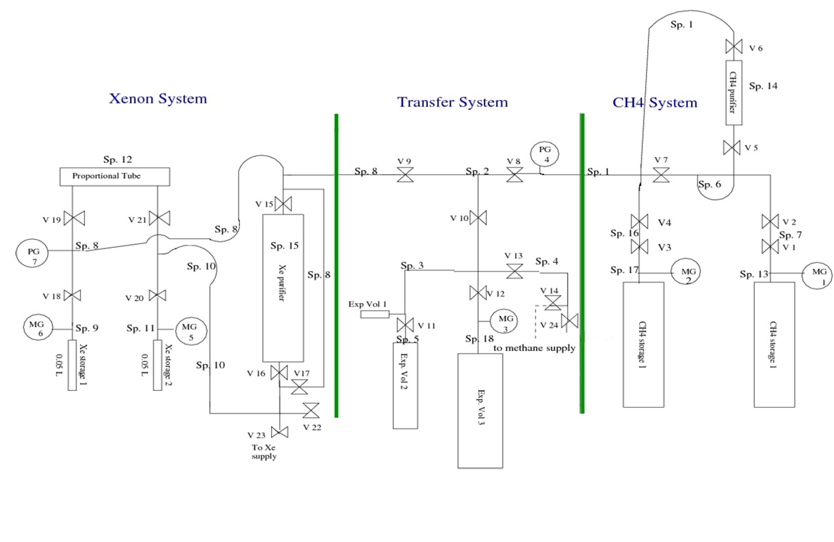
Gas Phase Experiment – Goals and Setup
Determine purification efficiency and study residual contamination in system.

Slide 19
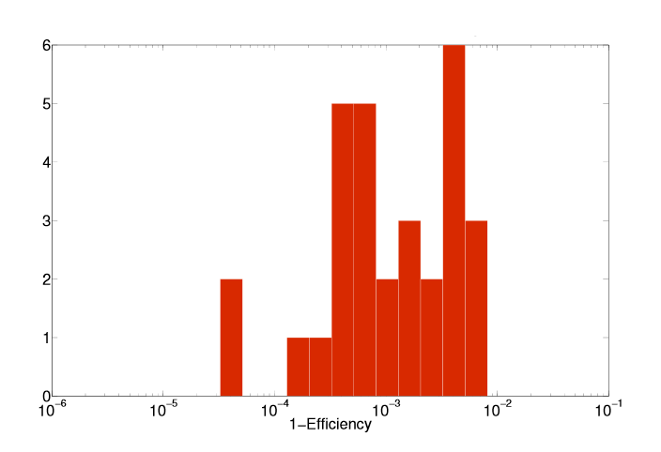
Gas Phase Experiment – Results
Define purification efficiency
Achieved purification efficiencies ranging from 99.2%-99.997%
Histogram of Purification Efficiency

Slide 20
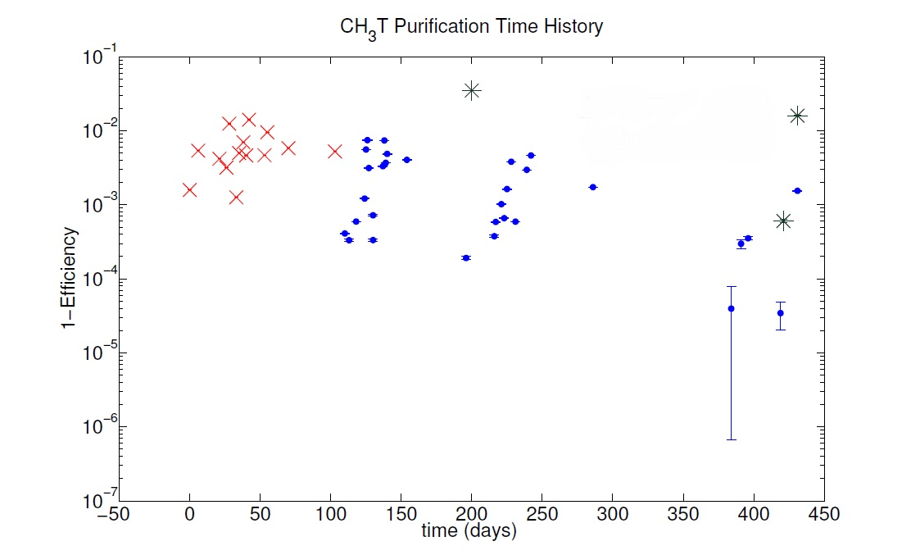

Gas Phase Experiment – Results
High flow rate lead to lower purification efficiency
Worst purification efficiency (96% $±1\%)$corresponds to highest flow rate (8 SLPM). Typical flow rate was 0.3 SLPM.

Slide 21
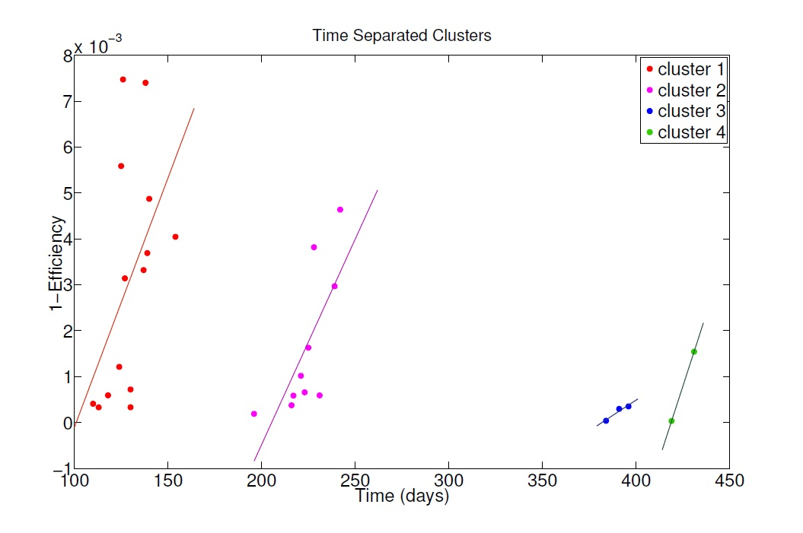
Gas Phase Experiment – Results
Increasing time between purifications increases purification efficiency.

Slide 22
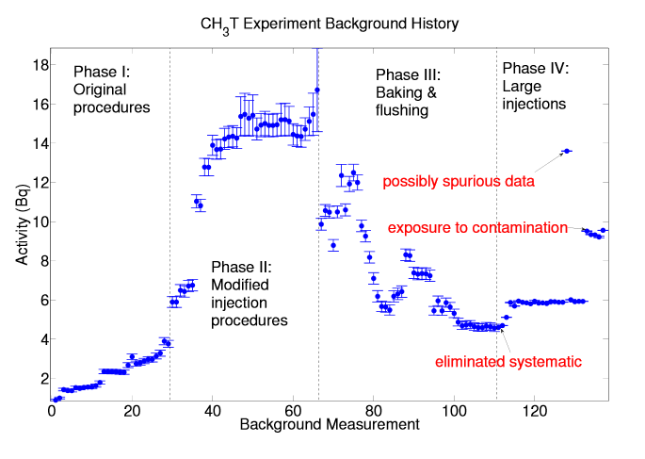
Gas Phase Experiment – Results
Tritated methane must be swept out of injection space
Tritiated methane must be purified prior to injection

Slide 23
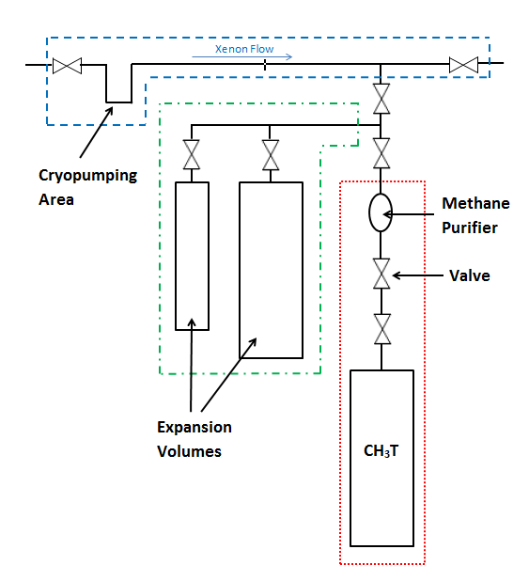
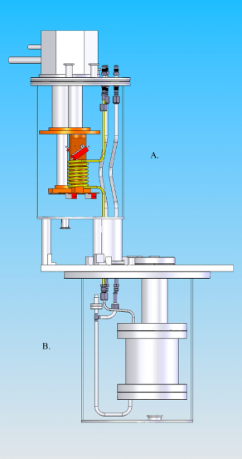
Liquid Phase Experiment – Goals and Setup
Apply what we learned in gas phase experiment to obtain high purification efficiency in liquid phase

Slide 24
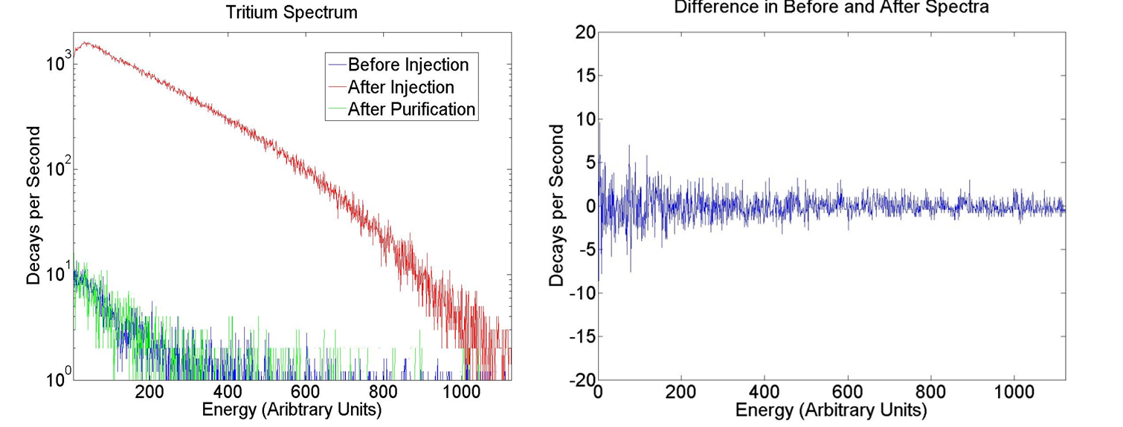
Liquid Phase Experiment- Results
Purification Efficiency Ranged from 0.999832 to 1.000087
Average of 99.9989% purification
Plastics made no difference in purification efficiency

Slide 25
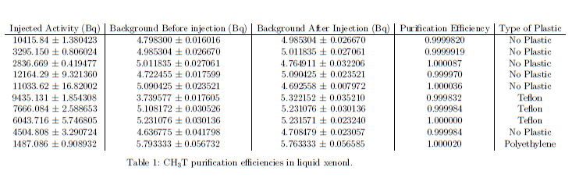
Liquid Phase Experiment- Results

Slide 26
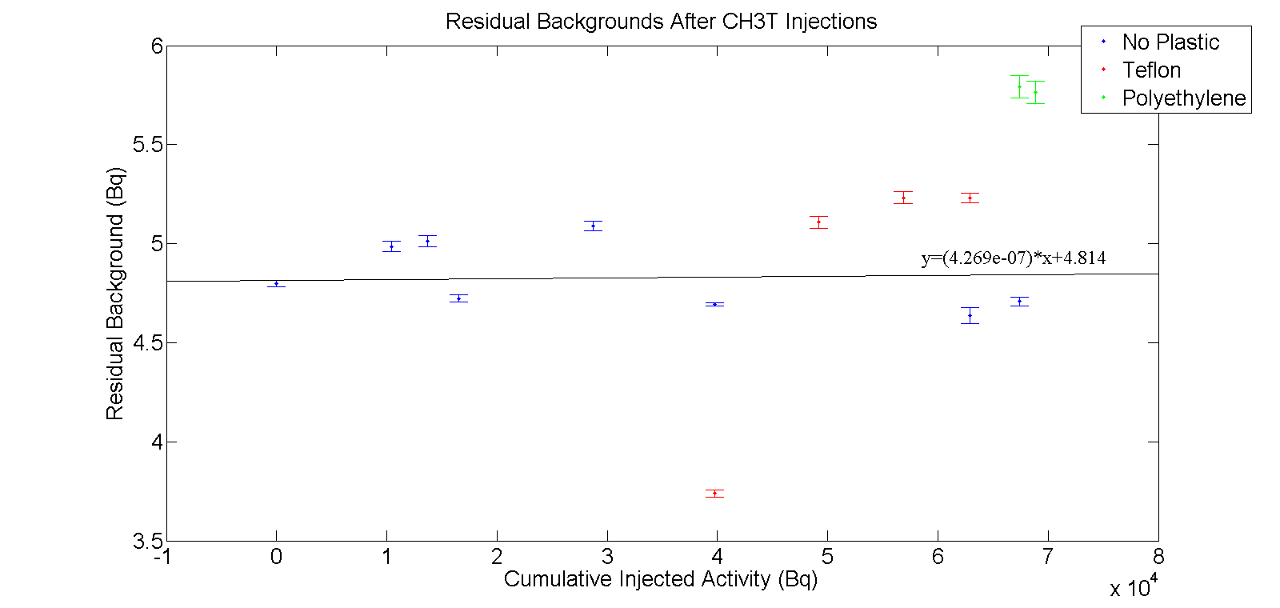
Liquid Phase Experiment- Results
Injected over 68,000 Bq with no rise in residual background rate
Linear fit has slope of 4.3e-7
Jump in rate in polyethylene data is from gain change

Slide 27
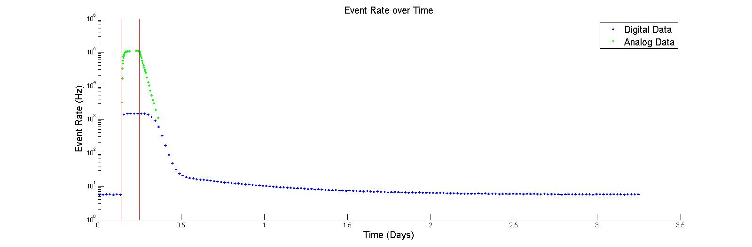
Liquid Phase Experiment- Out Gassing Study
First examined purification efficiency with polyethylene in the system
Take background data, inject, purify away

Slide 28
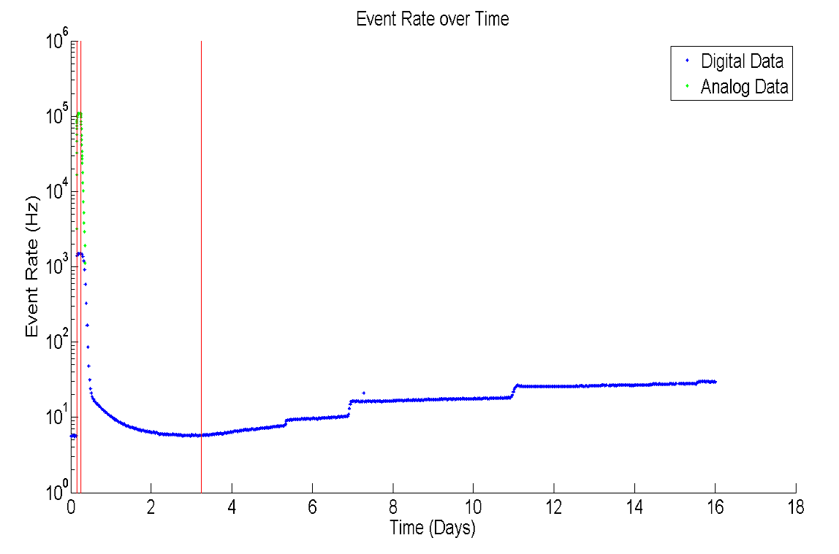
Liquid Phase Experiment- Results
Bypass the purifier to study outgassing rate
See two features – steps and gradual rise

Slide 29
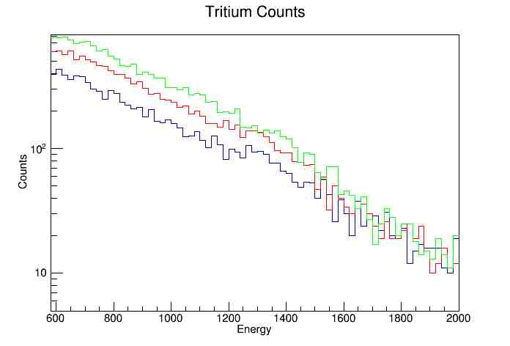

Liquid Phase Experiment- Results
Closer look at the steps – are they really tritium?
8833 $±93.98$events -> 13156 $±$ 114.70 events -> 17190 $±$131.11 events

Slide 30
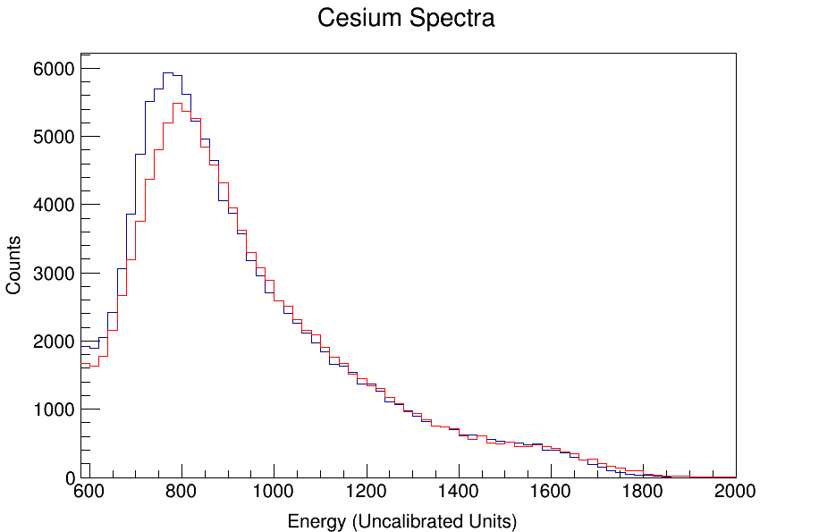
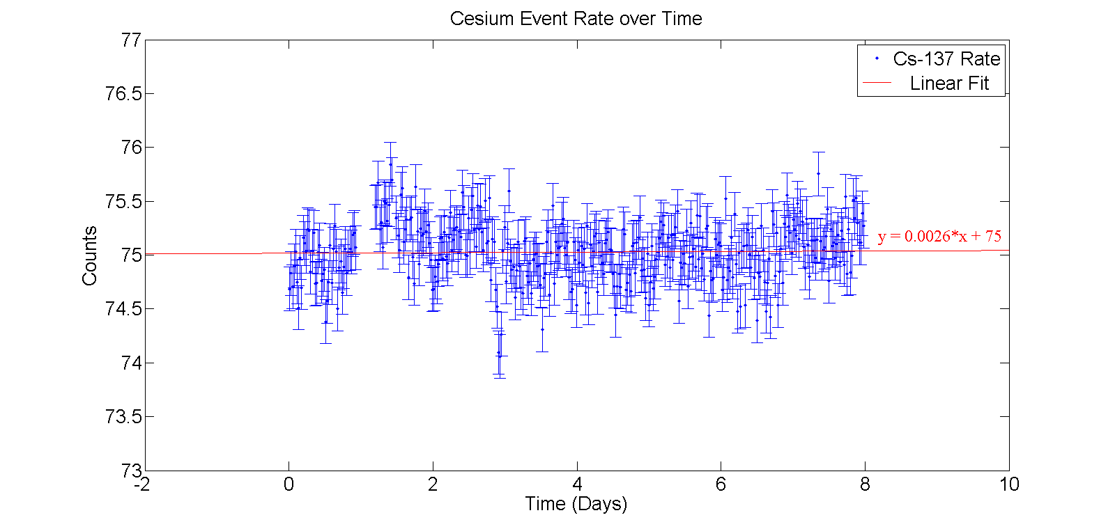
Liquid Phase Experiment- Results
Two possible explanations
Gain is drifting (shifts spectrum horizontally)
More tritium is showing up (shifts spectrum vertically)
Use cesium-137 peak to search for changes in gain
No change in gain Must be from pockets of tritium

Slide 31
Conditions for a Successful Calibration
Need enough calibration events to accurately measure tritium spectrum
Define “enough calibration events” as a factor of 100 over number of background events in 300 days
Sets a goal of about 17,000 events from calibration
Calibration can not significantly add to the background rate after being purified
Define tolerable contribution to the background rate as 5% increase
Sets limit on residual activity from calibration at 0.33 Bq

Slide 32
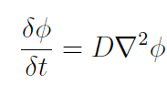


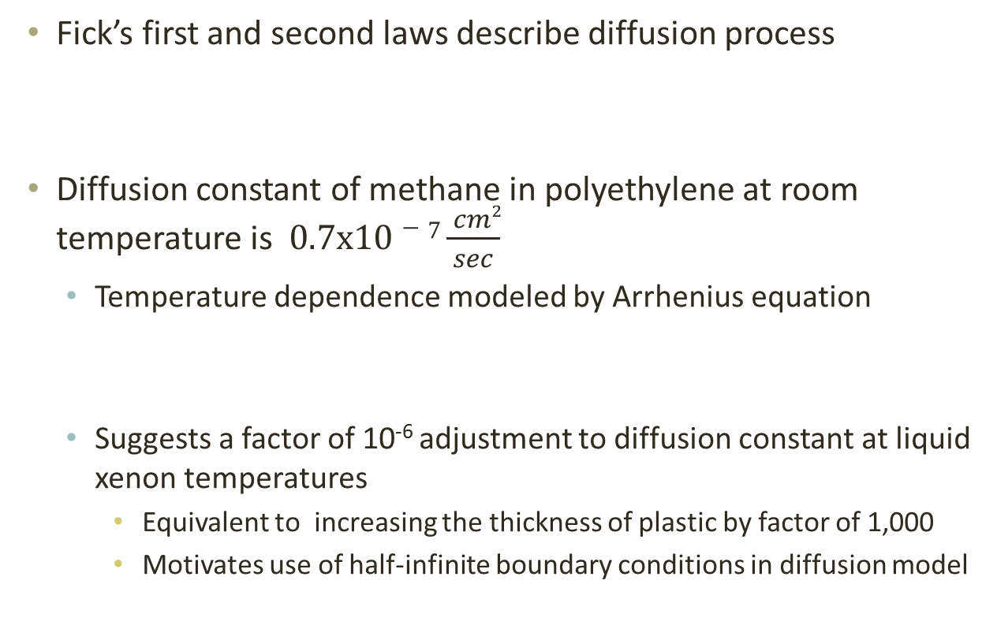
Determining How Much Activity to Inject into LUX
Fick’s first and second laws describe diffusion process
Diffusion constant of methane in polyethylene at room temperature is $0.7x10−7\frac{ cm2}{sec}$
Temperature dependence modeled by Arrhenius equation
Suggests a factor of 10⁻⁶ adjustment to diffusion constant at liquid xenon temperatures
Equivalent to increasing the thickness of plastic by factor of 1,000
Motivates use of half-infinite boundary conditions in diffusion model

Slide 33
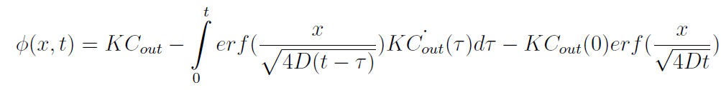
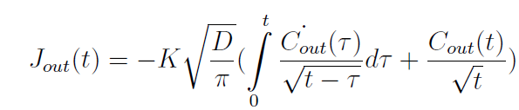

Determining How Much Activity to Inject into LUX
Analytic solution to Fick’s second law using half-infinite boundary conditions
Plug into Fick’s first law, evaluate at x=0 for out gassing
Define new constant

Slide 34
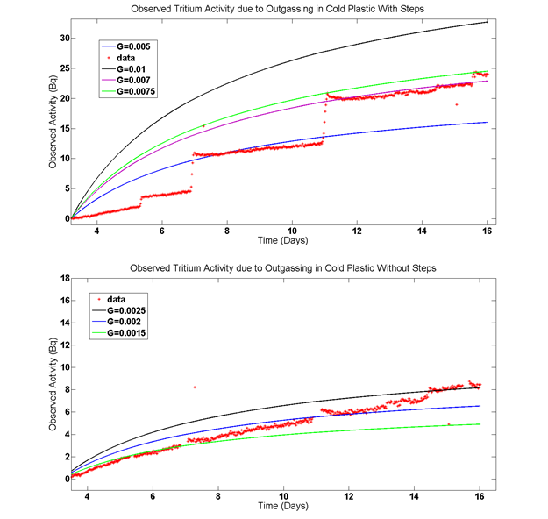
Determining How Much Activity to Inject into LUX
Fit to outgassing
data to determine G
0.001 < G < 0.01

Slide 35

Determining How Much Activity to Inject into LUX
Use constraints on G to numerically model CH₃T rate in LUX after a calibration
Use Fick’s laws to get flux from out gassing (J)
Use time dependent concentration that includes out gassing and purification

Slide 36
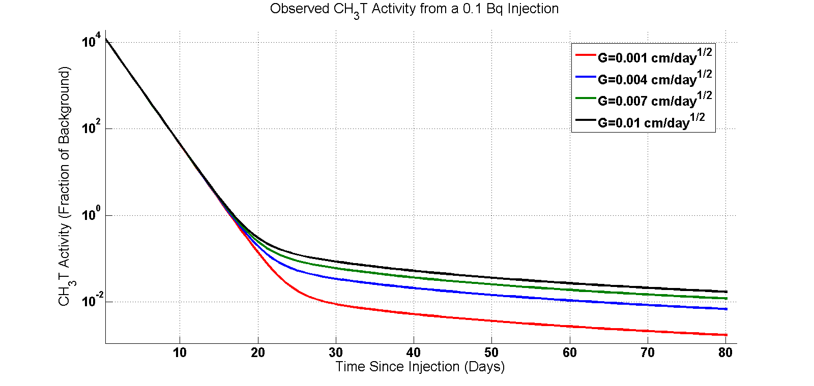
Determining How Much Activity to Inject into LUX
0.1 Bq injection gives ~15,000 events and reaches 5% of background in one to two months for all G values

Slide 37
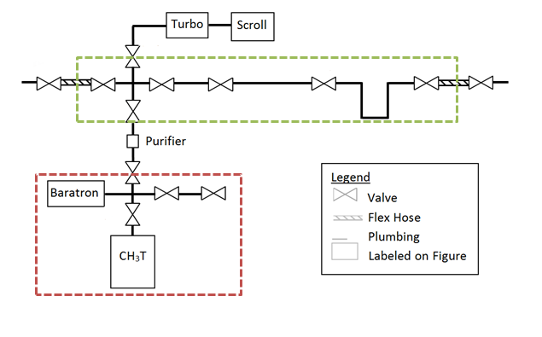
Tritium Injection System for LUX
Range on injection activities from 0.00625 Bq to 0.4 Bq
No cryopumping required
Flow Through Expansion Volumes
35 Bq Tritiated Methane Source

Slide 38
Conclusion
Dark Matter is thought to consist of WIMPs
LUX is searching for nuclear recoils from WIMPs
It is possible to use tritiated methane as an internal calibration source in xenon detectors
Hot zirconium getter can remove >99.98% of injected activity
Care must be taken to model outgassing and purification effects on injection activity
To meet LUX’s goal of ~17,000 calibration events with a return to 5% of initial background a 0.1 Bq injection is required

